Slide 1
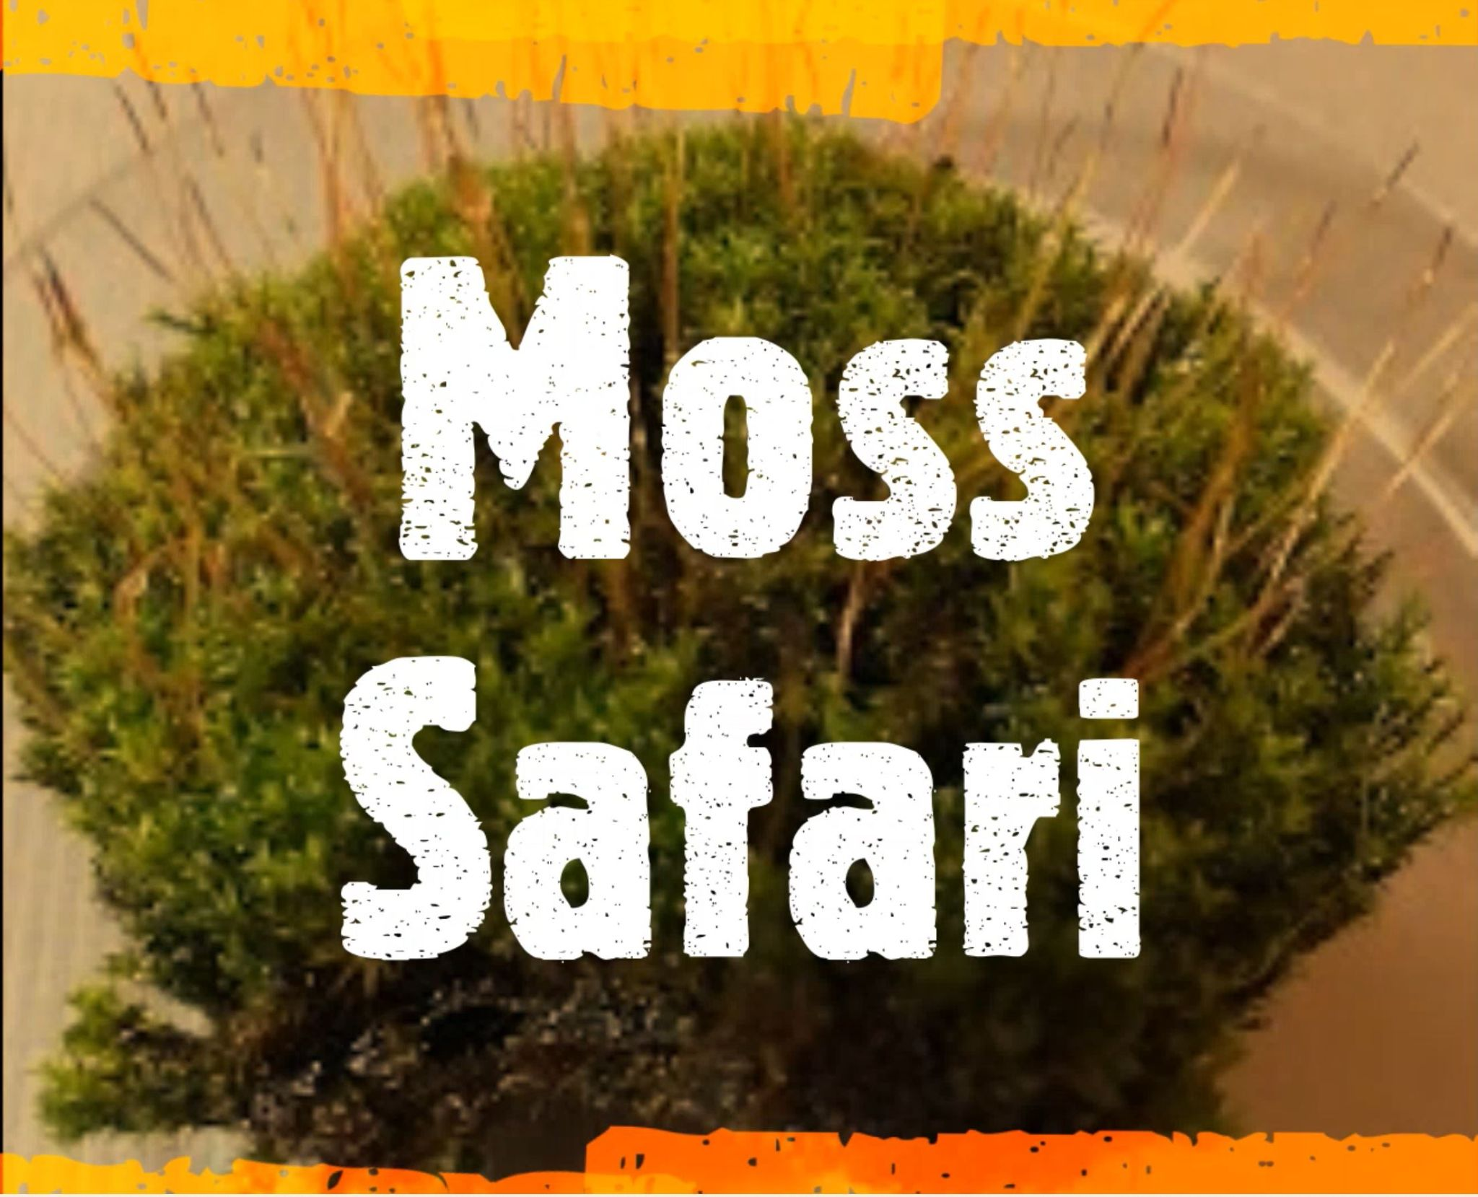
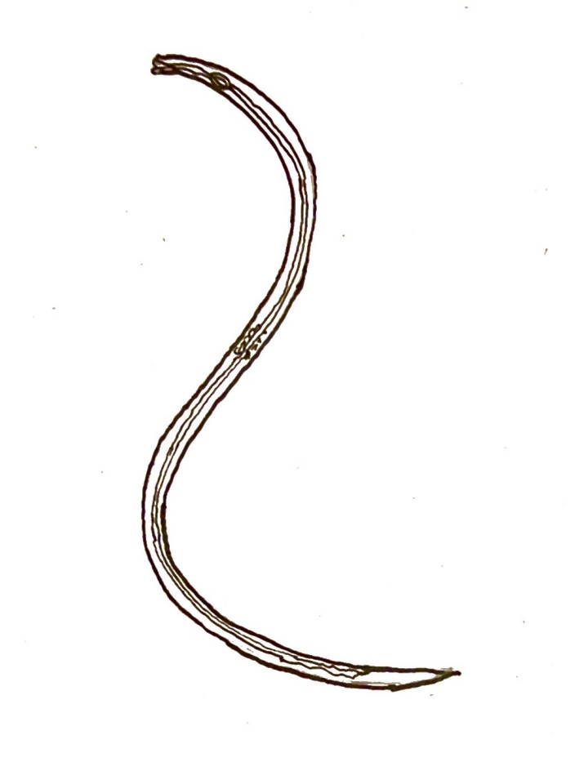
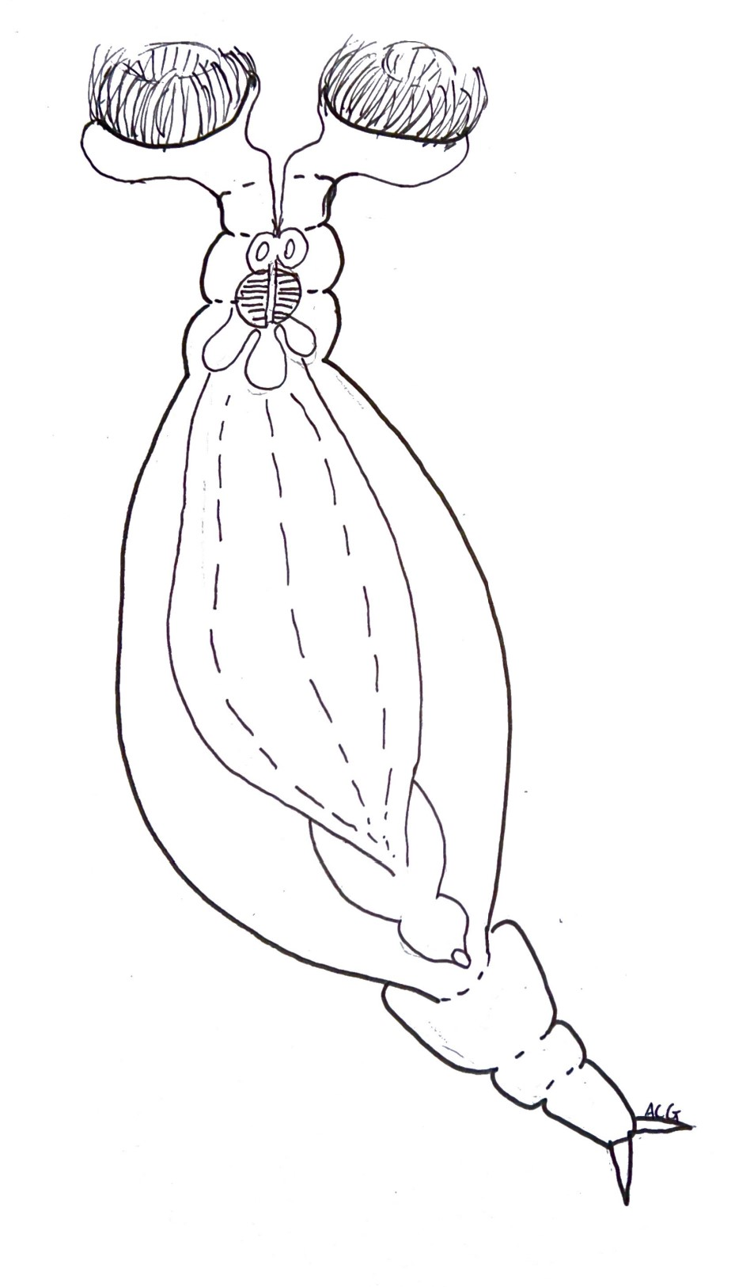
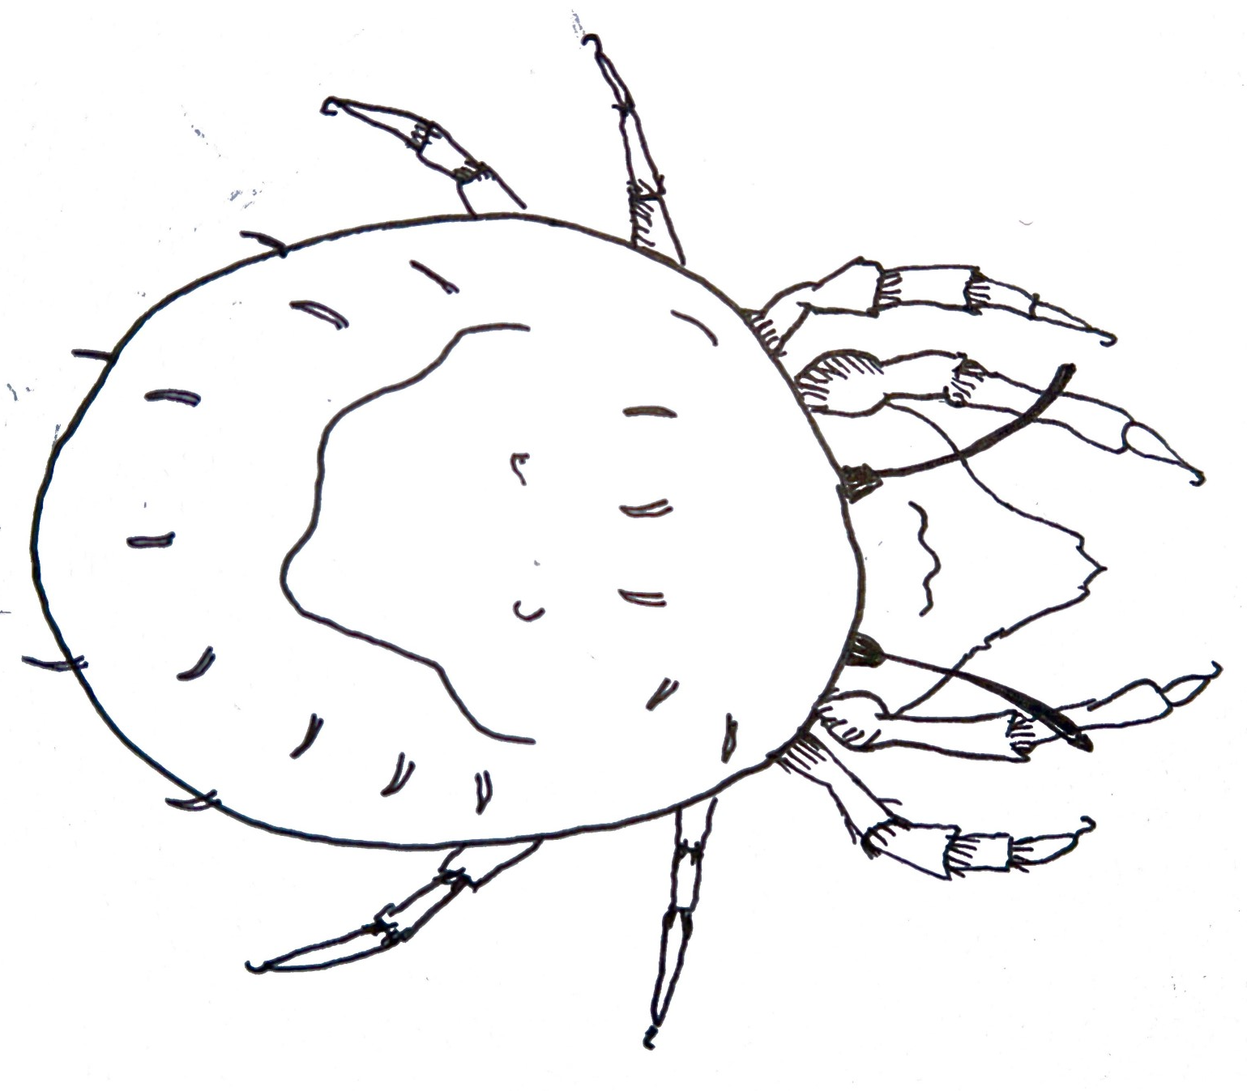
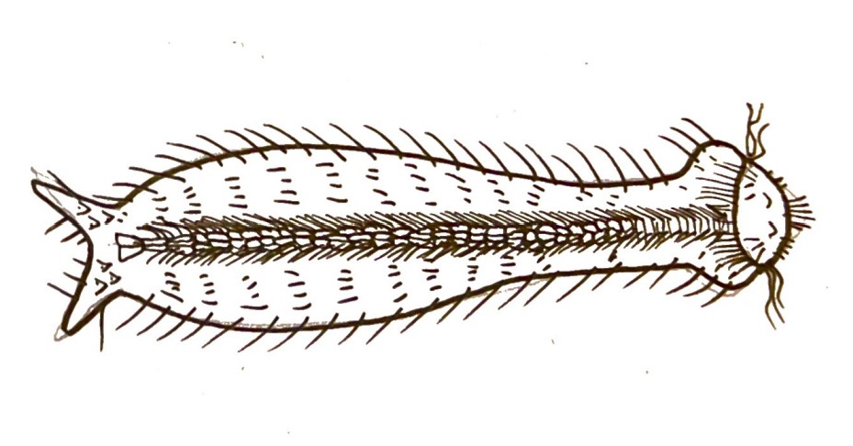
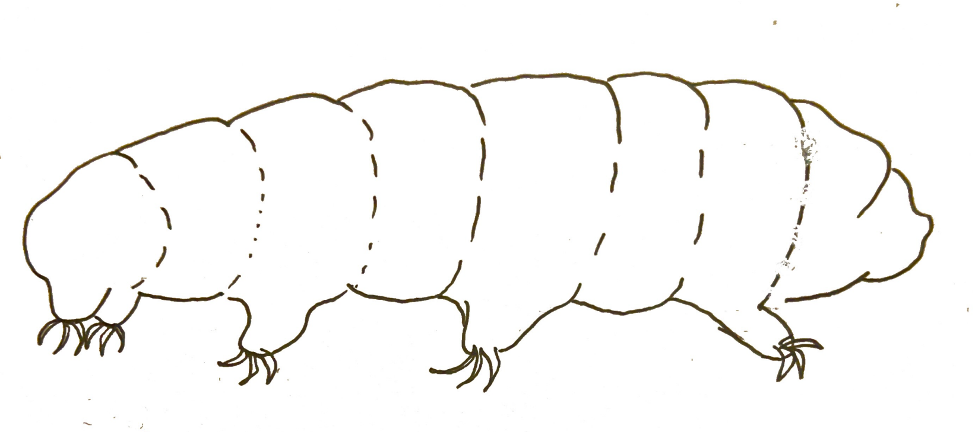
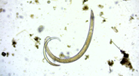
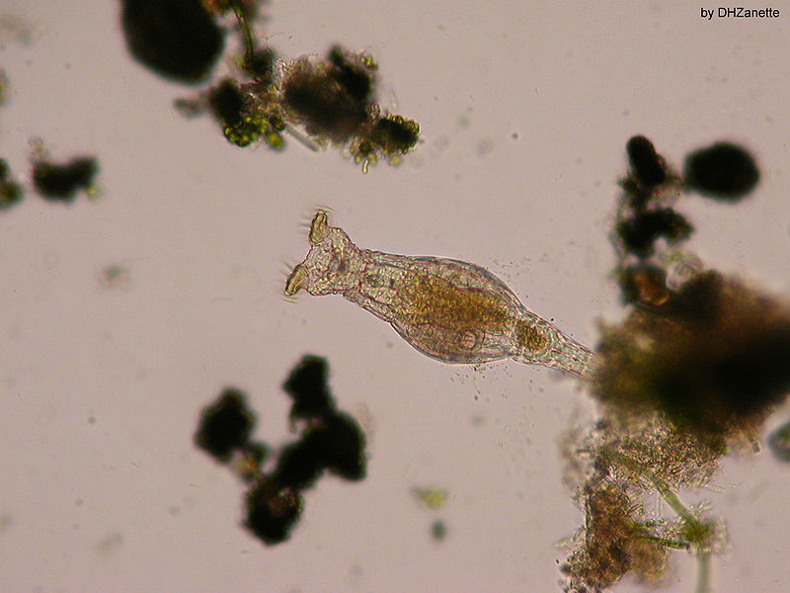
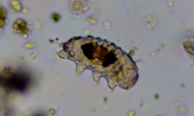
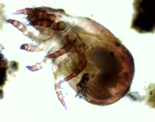
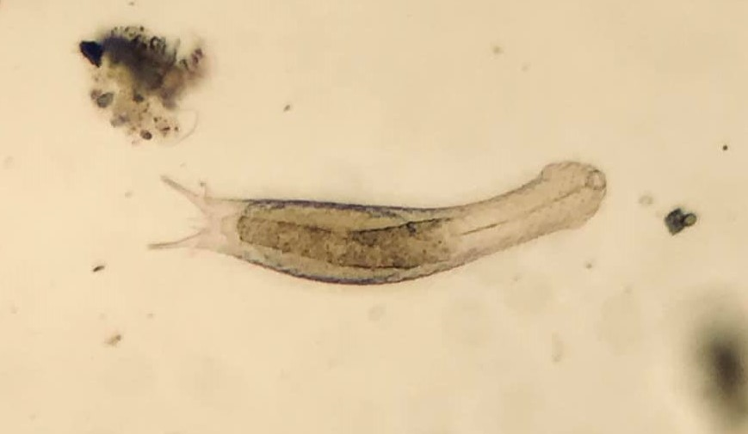
The ‘Big’ Five (multicellular animals at low magnifications)
Nematode
Rotifer
Tardigrade
Mite
Gastrotrich
Image: Damián H. Zanette/Wikipedia
Image: David McCamey
Nematode
Worm-like animal
Thrashing or wiggling.
Sometimes still.
Adaptations within moss
All have a sticky-tail adaptation.
Mouth parts indicate feeding approach, e.g., herbivore, carnivore, bacterivore.
Curl up into a ball to reduce water loss.
Migrate to rhizoids where there is moisture.
Ecological relevance
Huge relative biomass globally:
wild mammals (0.007 Gt C), nematodes (0.02 Gt C), humans (0.06 Gt C)
For each human, there are 60 billion nematodes living in the soil.
Scientitific knowns
Caenorhabditis elegans is a model organism – one that scientists use in scientific research.
First organism to have its genome and connectome sequenced.
Has won three Nobel prizes, including death genes.
Scientitific
unknowns
Live research on:
aging, cell death, development, nerves.
Human degenerative diseases, including Alzheimer’s, Parkinson’s, and Huntington’s diseases.
Also used in experiments on the International Space Station.
Illustration and photo credits: Andy Chandler-Grevatt

Slide 2
The ‘Big’ Five (multicellular animals at low magnifications)
Rotifer
Has rotating hairs on its head.
These cilia draw in food to its jaws (trophii).
Walks like an inchworm. Uses its two toes to anchor to the surface.
Image: Damián H. Zanette/Wikipedia
Adaptations within moss
All female; reproduces by laying eggs (parthenogenesis).
Bdelloid (leech-like) rotifer common in moss.
Causes currents to draw food into its mouth and filters water for food particles.
Different modes – goes into a dormant state called anhydrobiosis when conditions get dry.
Ecological relevance
Important food source in freshwater (and some salt) ecosystems.
Climate indicators (ice cores, trophi).
Scientitific knowns
Used as biological indicators of freshwater.
When in anhydrobiosis, they stop aging. Siberian ice core – woke up after 24,000 years and reproduced.
Scientitific
unknowns
Live research on:
ISS surviving radiation
Chemical ecology
Jaw evolution and development
Tardigrade
Water bear with eight clawed legs and a small snout.
If moving, it looks like it is moonwalking.
Adaptations within moss
Mostly female, but males exist. Lays eggs inside or outside shed skin.
Uses its claws to move around moss.
Turns into a tun, when under environmental stress, that can survive extreme conditions.
Two main groups: heterotardigrada (armoured) and eutardigrada (smooth).
Ecological relevance
Exists in every biome.
Model extremophiles – can survive high and low temperatures, high pressures, radiation, etc.
Coevolution with mosses and lichens.
Scientitific knowns
Extremely resilient to environmental stress, e.g., UV, desiccation, radiation, temperatures, pressure.
We are still learning how.
Scientitific
unknowns
Live research on:
New species being found, e.g., 2018
Research on tardigrades themselves – Bacon lab.
Illustration and photo credits: Andy Chandler-Grevatt

Slide 3
The ‘Big’ Five (multicellular animals at low magnifications)
Mite
Looks large and dark under the microscope. Eight legs; big body.
When moving, it moves its legs like an insect.
Adaptations within moss
Moss mites belong to the huge Oribatida family.
Hooks on the end of legs to move through moss stems.
Thick exoskeleton for protection and to slow drying out.
Often moves out of moss when the moss dries up or goes into a hibernation state called diapause.
Ecological relevance
Most species live in soil.
Extremely important decomposers in soils.
Plays dead when disturbed.
Most are herbivores or detritivores, but some are carnivorous.
Scientitific knowns
Thousands of known species, estimated to be 100,000s in total.
They seem to be important in soil ecosystems.
Scientitific
unknowns
Role in soil health is being investigated in agriculture.
Role is soil ecosystems.
Gastrotrich
Looks like a hairy flatworm. Known as hairy belly.
Swims fast, darting around; uses cilia on the body to swim.
Image: David McCamey
Adaptations within moss
All have a sticky-tail adaptation.
Lays two types of egg – quick hatchers or delayed hatchers to cope with changing environments.
Have fast life cycles to tolerate change.
Some species form cysts to survive harsh environmental conditions.
Ecological relevance
They eat mainly bacteria by sucking bacteria into their mouths.
Some species have hooks and spines on their body to deter predators.
Scientitific knowns
800 species known, many more to be discovered.
Scientitific
unknowns
Very little is known about the diversity of gastrotriches and they are being studied.
Their reproduction is poorly understood.
Illustration and photo credits: Andy Chandler-Grevatt

